Slide 1
Cainan Black Senior Project
Java Calculator Application

Slide 2
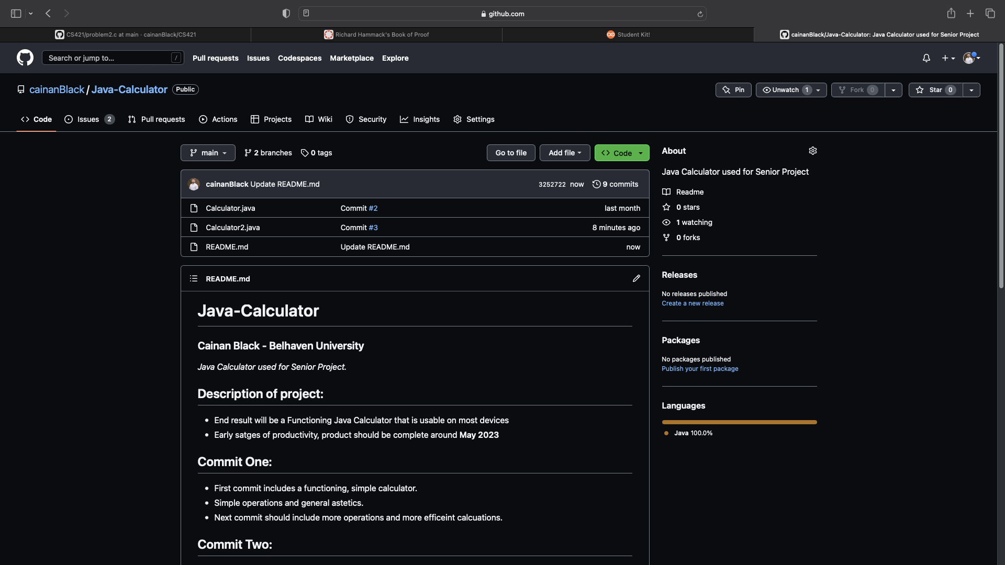
Git Repo
Added all the code and slides to the GitHub repo.
Third commit is up.

Slide 3
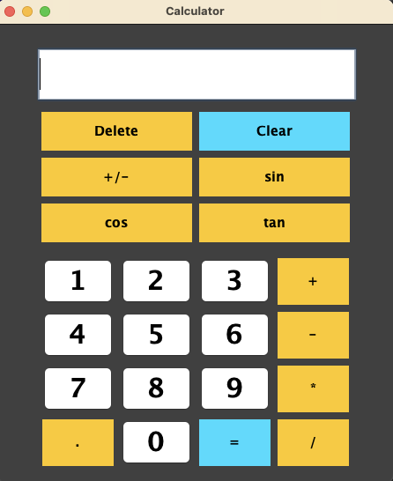
How it looks, for right now:
Not many differences. New colors on buttons that I felt needed to stand out. Slight different notation on the sin, cos, and tan buttons.

Slide 4
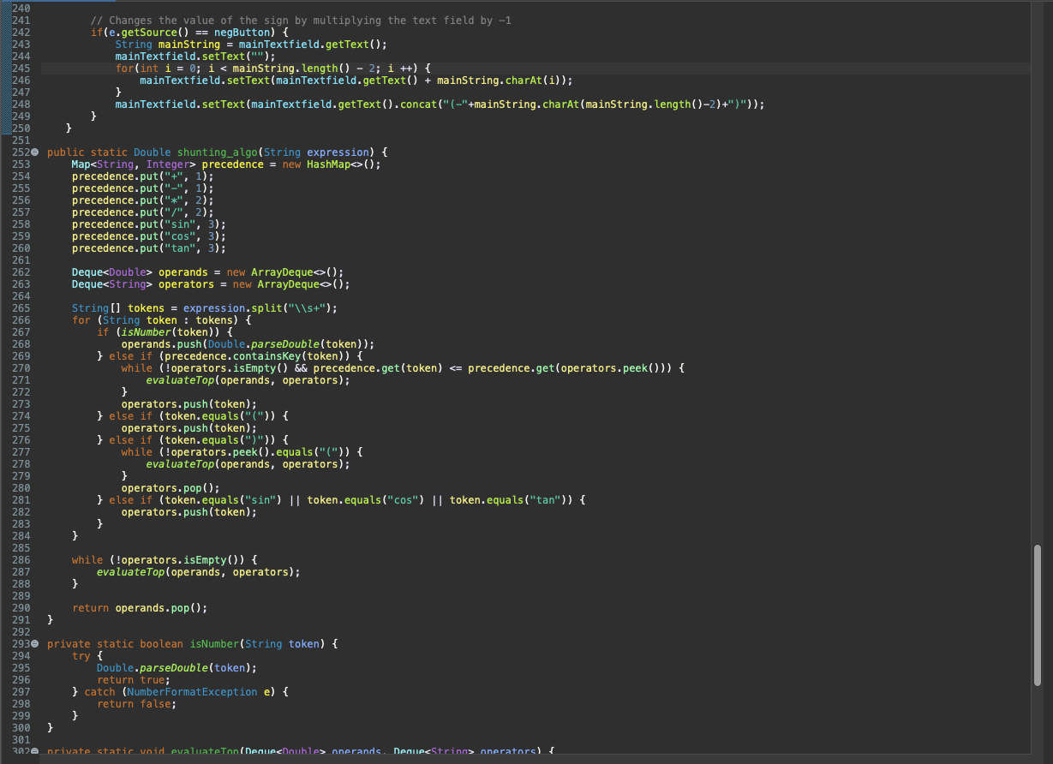
Main Code:
Very small and hard to read, sorry! (Code is in the repo if you want to look at it closer)
Implemented the Shunting Yard Algorithm to sort and evaluate the final expression as a string.

Slide 5

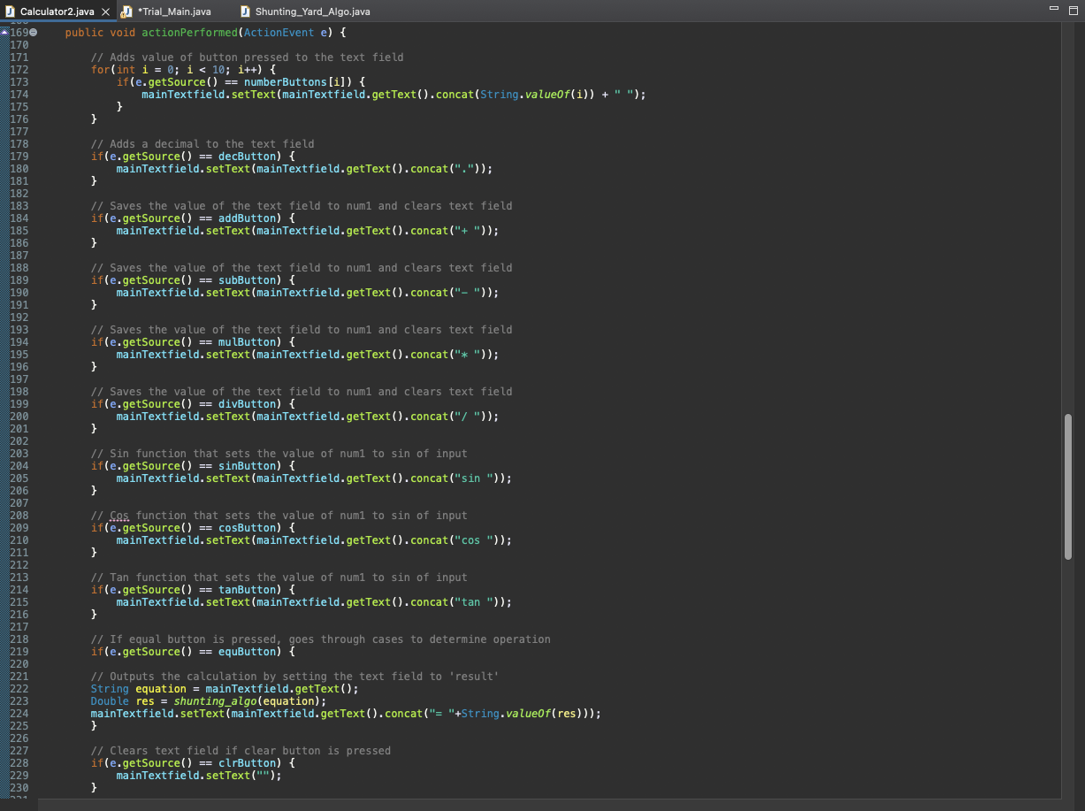
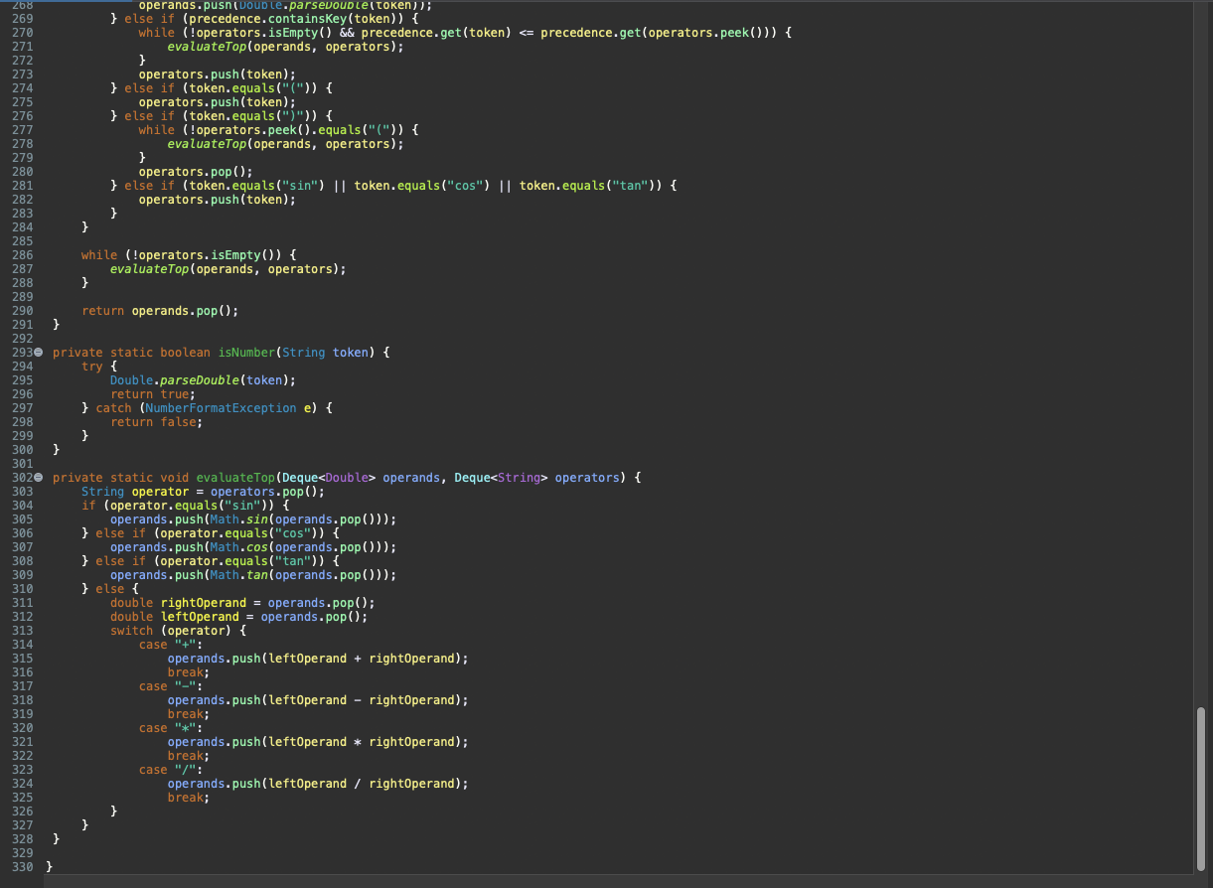
Additional Images of Code
Yes, very hard to read.
(all my code is in repo)

Slide 6
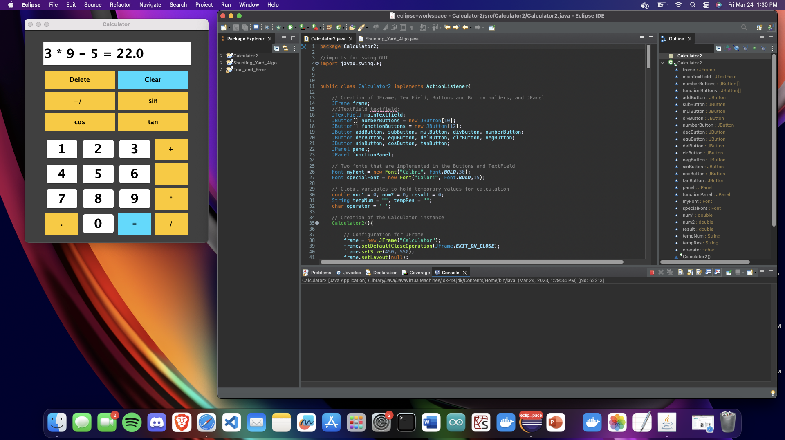

Pictures of Code Running.
Solid execution for the stage that it is in. Will have more functionality in the future.

Slide 7
Work for next week
More functions
Make everything look a little better. “Prettier.”

